Slide 1
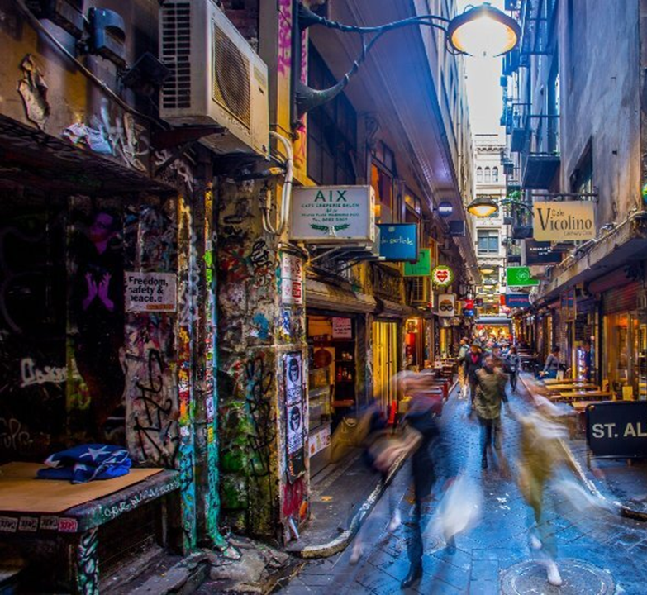
Eat & Drink
Melbourne (2002 – 2020)
David Salim
Ron Fu
Sam Vuong
Steven Bouios
Group 7
Notes:
Melbourne increasing in population – also known for its good food and café culture
See the increase of number of establishments in city of Melbourne and seating capacity to see the rate of growth over the years of 2002-2022
Which areas have a larger number (hotspot) of establishments and seating capacity

Slide 2
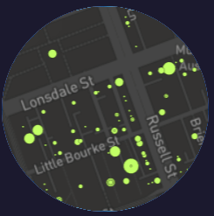


Agenda
Our story
Plan & Design
Coding Approaches
Data Munging
Process
Final visualisation - demo
Notes:
Story Tell you about our story.
Coding Approaches Each page visualisation required different coding approaches:
we’d like to walk you through the approaches for:
The dashboard
Xxx
And the Map
Data Munging & Process
We’ll walk you through the data munging techniques we used to retrieve, clean, transpose
We will also take you through the journey of the whole process, highlighting the various software that was used to get to the final visual product.
Final visualisation - demo
And finally we’d love to show you a demo.

Slide 3
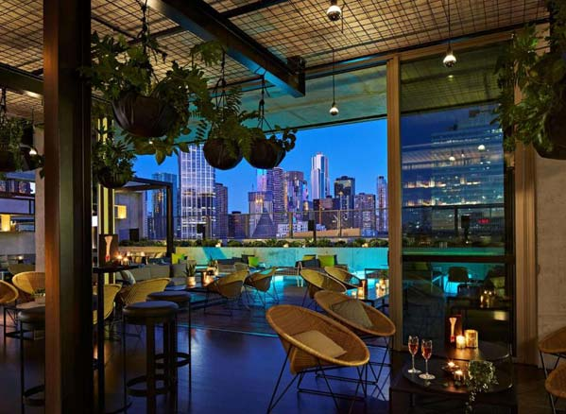

Our story
Cafes & Restaurants
City of Melbourne
2002 to 2022
Notes:
Melbourne increasing in population – also known for its eclectic good food and café culture.
See the increase of number of establishments in city of Melbourne and seating capacity to see the rate of growth over the years of 2002-2022
Which areas have a larger number (hotspot) of establishments and seating capacity
Which area should you go to if you are with a larger group of people
Which areas have more restaurants or cafes/ more variety
Ill handover to XXX

Slide 4

Plan & Design
View 1 - Dashboard
View 2 - Table
Map

Slide 5
Coding approach
Dashboard
Table
Map

Slide 6
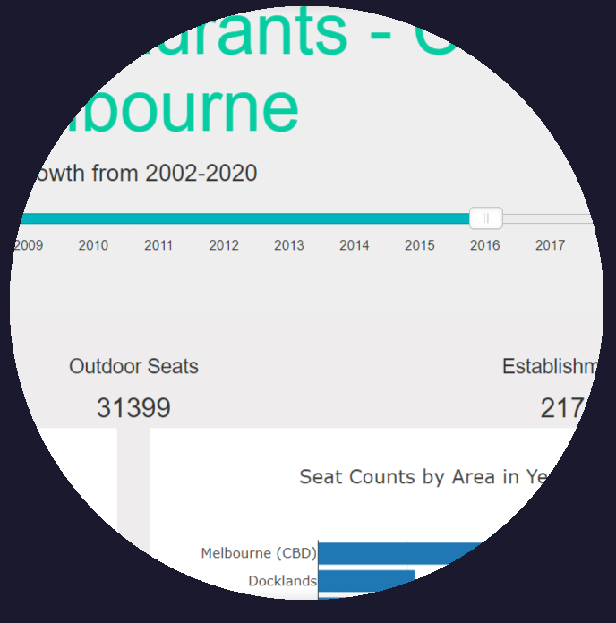
Dashboard
Slider (JS library)
Function to build charts
D3
Notes:
Coding approach - dashboard
Slider (js library)
Built a function for each bar chart
Build a function for the number chart (the 3 figures above the bar charts)
Use d3 to source to get data from api. Api built tailored to the requirements of each chart - data processing validation is all done within api

Slide 7
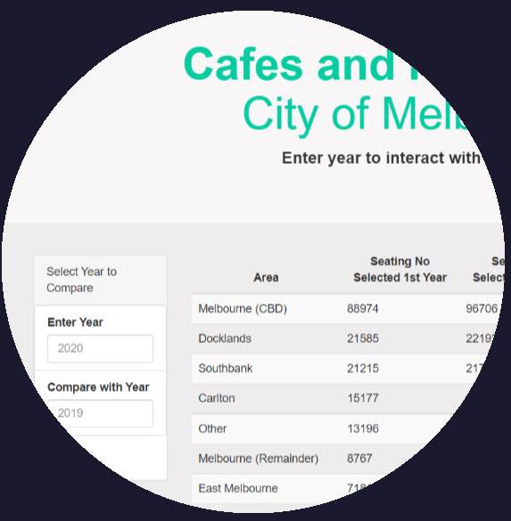
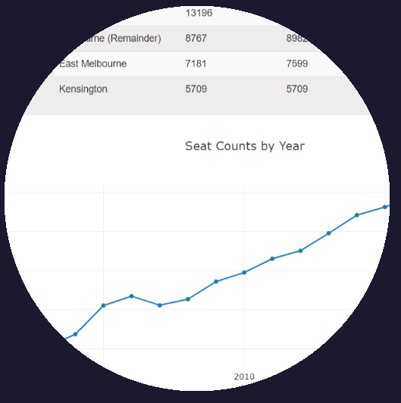
Table
D3
API – specify 2 different year input

Slide 8
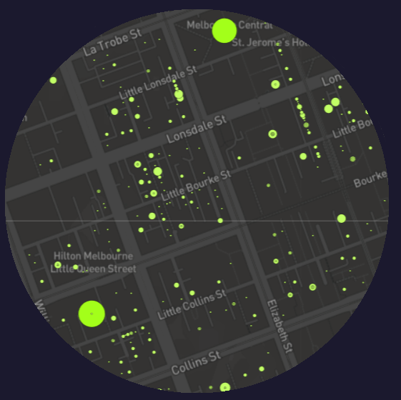
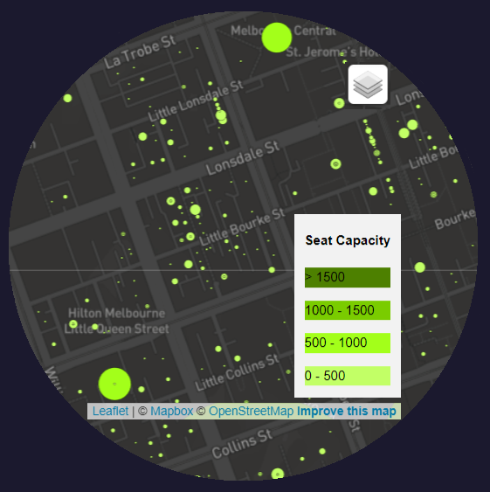
Map
Leaflet
Control layers:
Tile layers
Data by year
Notes:
Coding approach – map
Leaflet to build map
D3 to source data from api
Layers control – tile layers/location of establishment by year and capacity

Slide 9
Data Munging

Slide 10
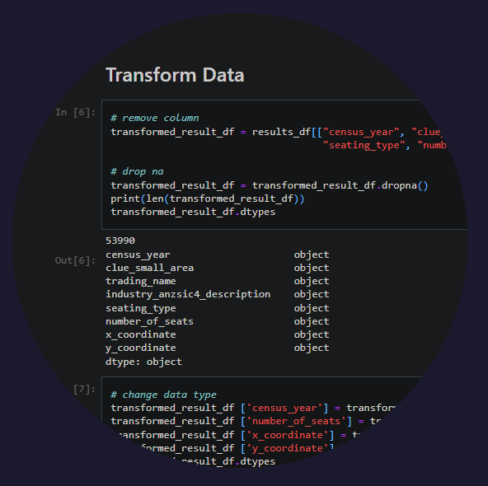
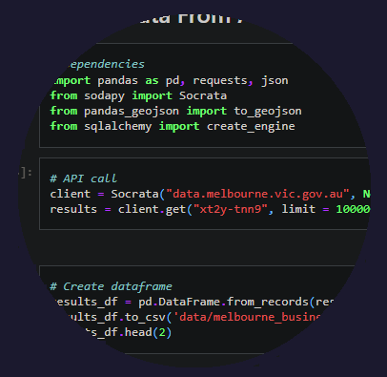
Data Munging
Pandas: dataframe
remove columns,
dropna,
drop duplicates,
change data type,
replace
Notes:
Data munging
Api call
Pandas to create df – remove columns, drop NA, change data type, (drop duplicates for bottom bar chart), groupby (by suburb, industry), (replace function for everything out of top 10)

Slide 11
Process

Slide 12
Process
melbourne.vic.gov.au
.ipynb
Python flask server
JS
API: chart
.csv
API: map
sqlite
API: table
.html
Notes:
Process
Do api calls
Data cleaning
Clean data to database (sqlite, data more than 10k)
Develop python flask app – connect to database, grab data, create api for data
Develop javascript files to create charts that get data from the api we developed

Slide 13
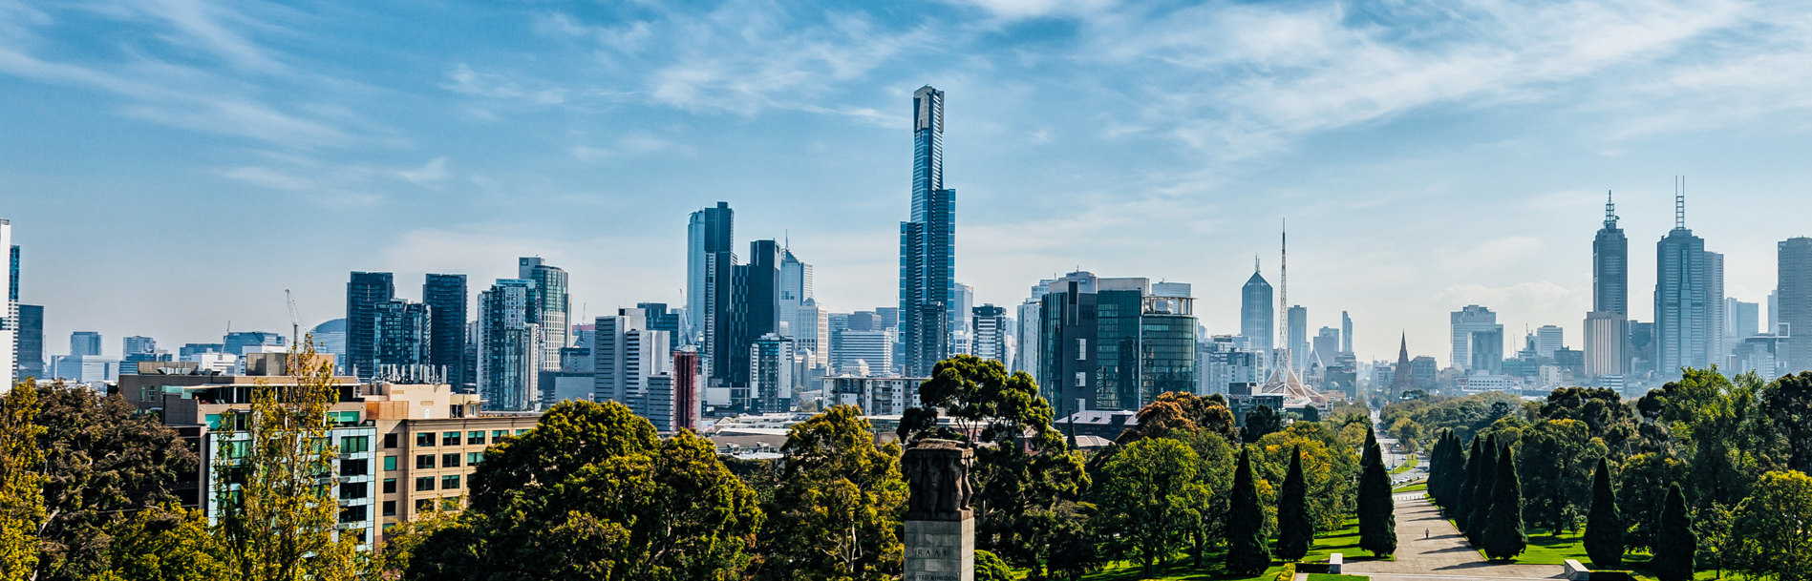
Demo
Notes:
Dashboard shows us total number of indoor and outdoor seats, as well as establishments of each year, seating capacity of sub categories, seating capacity by area, and number of establishments by area per year.
Not finalised: Table which grabs data from api (sorted by year)
Map page shows distribution of capacity in each area and restaurant

Slide 14


Thank You

